Slide 1

Dealership Opportunity

Slide 2

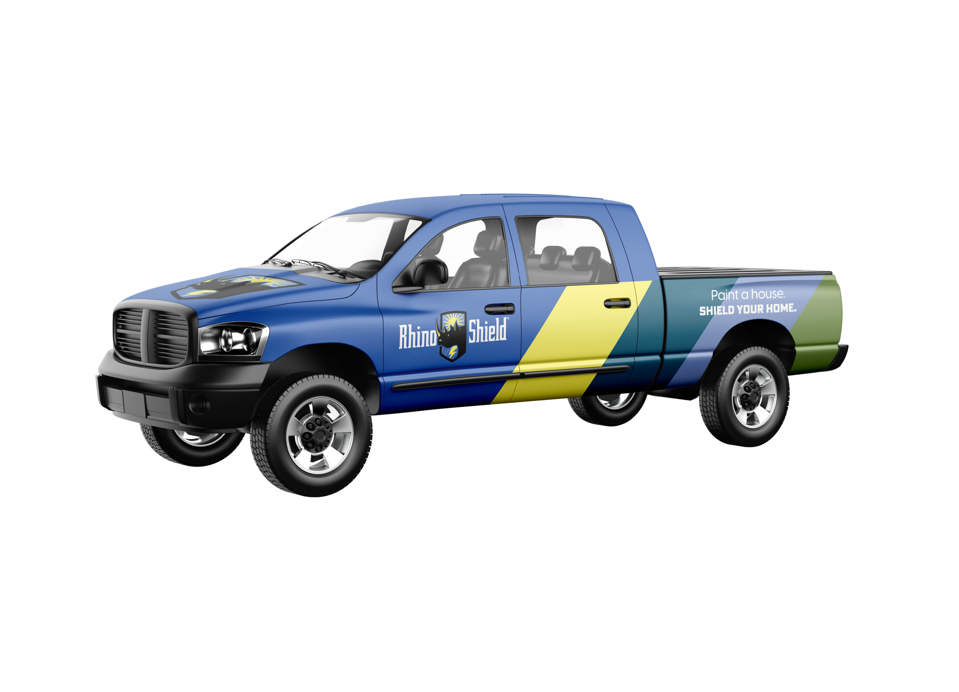
The opportunity
Build a million-dollar business with less than
$75,000 as an initial investment.
Exclusive Territory
No-Franchise Fees
Robust Marketing Support
Complete Sales Training
Installation & Crew Training
Dealer & Financial Management Guidance
Average Rhino Shield Dealer $1.5MM+ Annual Revenues—click here to watch a short video.

Slide 3

The investment
Build a million-dollar business with less than
$75,000 initial investment.
No-Franchise Fees—we simply require a one-time $20,000 product & marketing deposit to secure exclusivity and license the Rhino Shield Brand.
Successful Rhino Shield Dealers require $35,000 to $40,000 in initial marketing spend
  Best practice is 15-18% of Revenues reinvested in marketing
Equipment investment will vary by dealer. You may need up to $15,000-$20,000.
The Deposit
$15,000 Product Credit
Rhino Shield Website Build
12 Months SEO
Edits/Changes
Review Management System
*website maintenance $200 month after 1 year

Slide 4
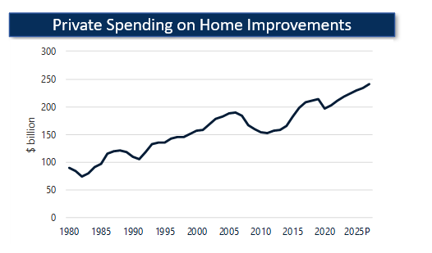
The Exterior Coatings market
Private spending on home improvements and repairs, including exterior coating & paint, is a ~$230 billion industry, expected to grow at around 3% through 2026*.
As discretionary income and private spending on home improvements continues to increase, your Rhino Shield Dealership will benefit from more people investing in protecting their home.
*Source: IBIS and CSHW estimates.

Slide 5

The Exterior Coatings market
House Starts are up—and still behind it’s prior peak by 60%
Coatings demand is high
Exterior Improvements are a high priority to homeowners
Source: Housing starts from the U.S. Census Bureau.

Slide 6

Why Amcoat?
For more than two decades, AmCoat Industrial has helped grow and develop coatings dealerships across the U.S.
AmCoat Industrial is a leading manufacturer of high-performance coatings for walls, concrete, roofs and specialty industrial applications. AmCoat is home to some of the most recognizable brands in the U.S., most notably Rhino Shield Ceramic Elastomeric Coating and Floor Shield 100% Polyaspartic Concrete Coating. Through a network of independent dealers, AmCoat Distributes its products nationally and internationally, coating thousands of homes and buildings, including commercial and industrial applications.
“For more than two decades, we have helped develop and grow independent dealerships into multi-million-dollar businesses. We can help you launch and grow your business too.”
Terry Andre, Chief Executive Officer

Slide 7
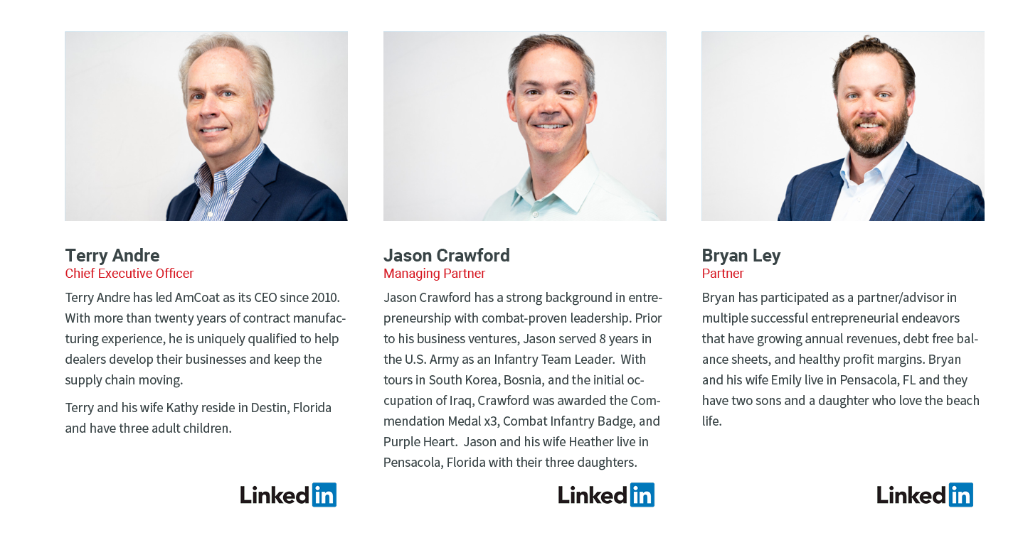
Our Team

Slide 8


Slide 9

Why Rhino Shield?
Launched in 2000, the Rhino Shield brand has grown to be the nationally-recognized leader in premium exterior coatings. Its proprietary formula beautifully protects against the elements, while coating your home and protecting your greatest investment - backed by a 25-year product guarantee.

Slide 10
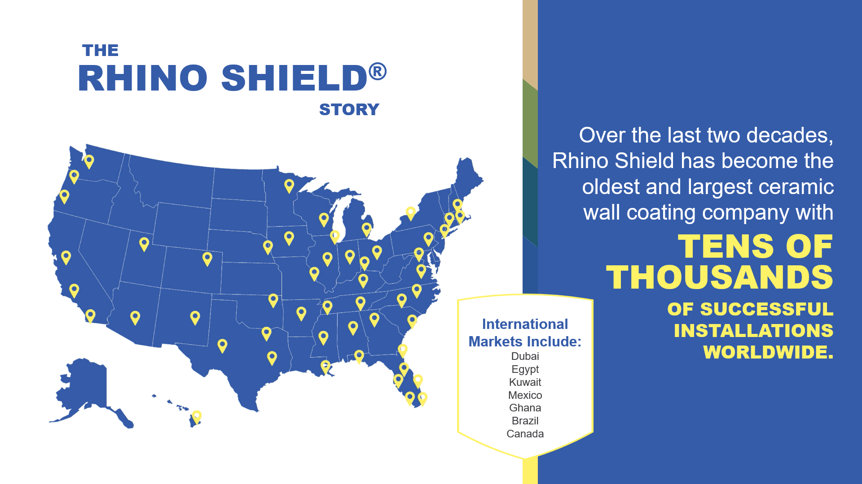
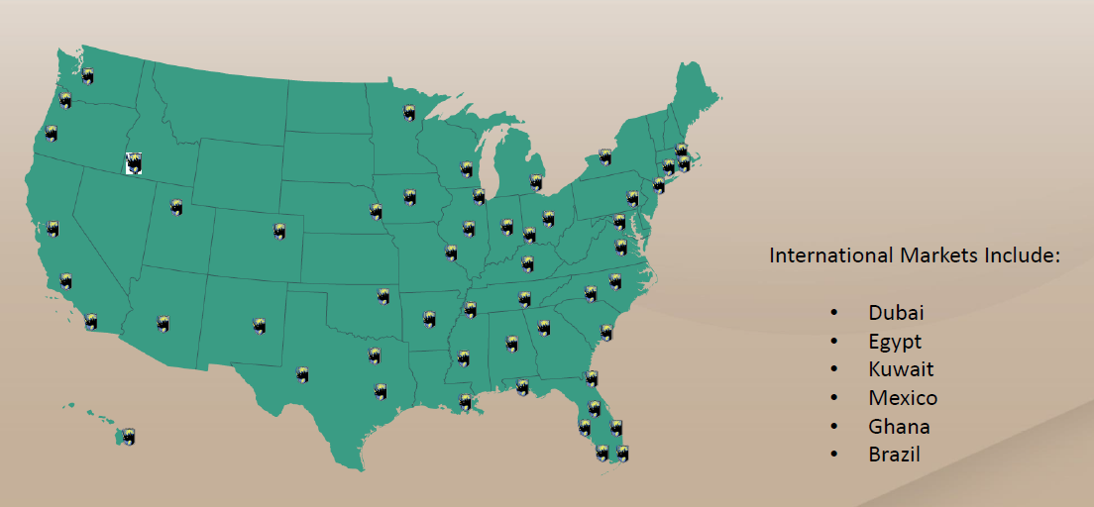
Why Rhino Shield?
For more than two decades, Rhino Shield has become the market leader in ceramic wall coating business, with tens of thousands of installations across the US and internationally.

Slide 11
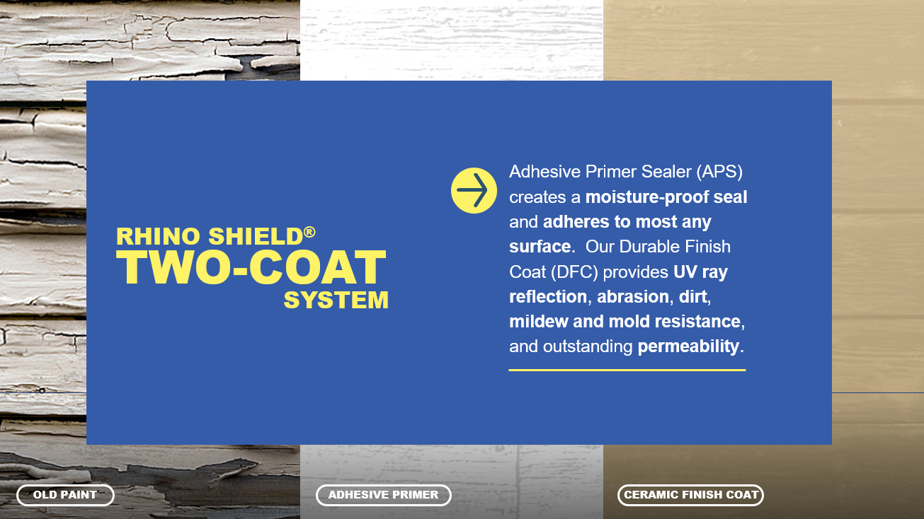



Why Rhino Shield?
TWO Part Coatings System to protect against the elements:
Adhesive Primer Sealer (APS) creates a
moisture proof seal and adheres to most any surface . Our
Durable Finish Coat (DFC) provides UV ray reflection , abrasion, dirt, mildew and mold resistance ,
and outstanding permeability-

Slide 12
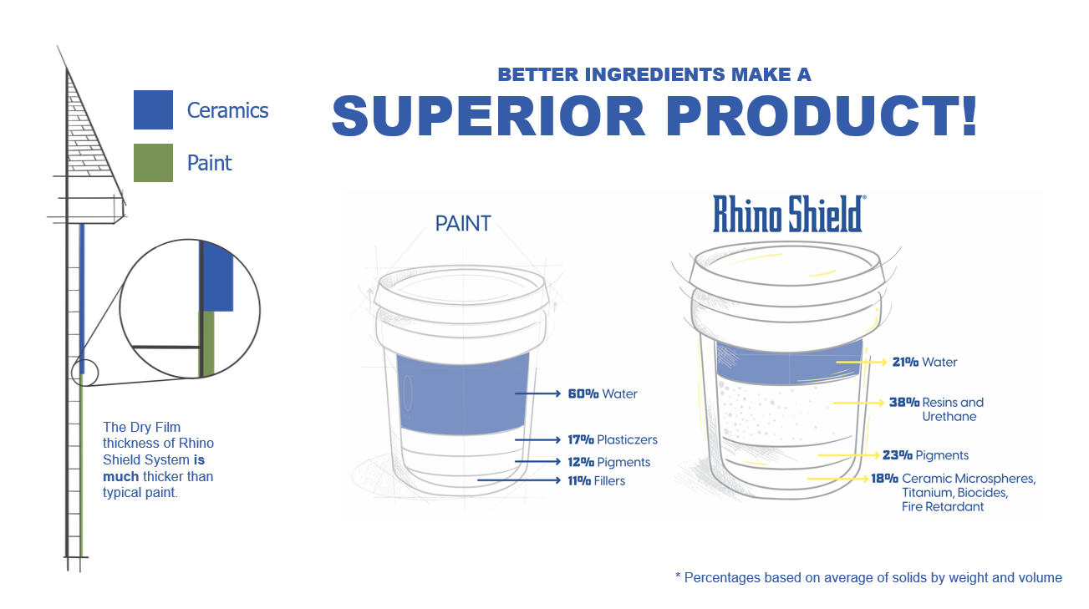

Slide 13
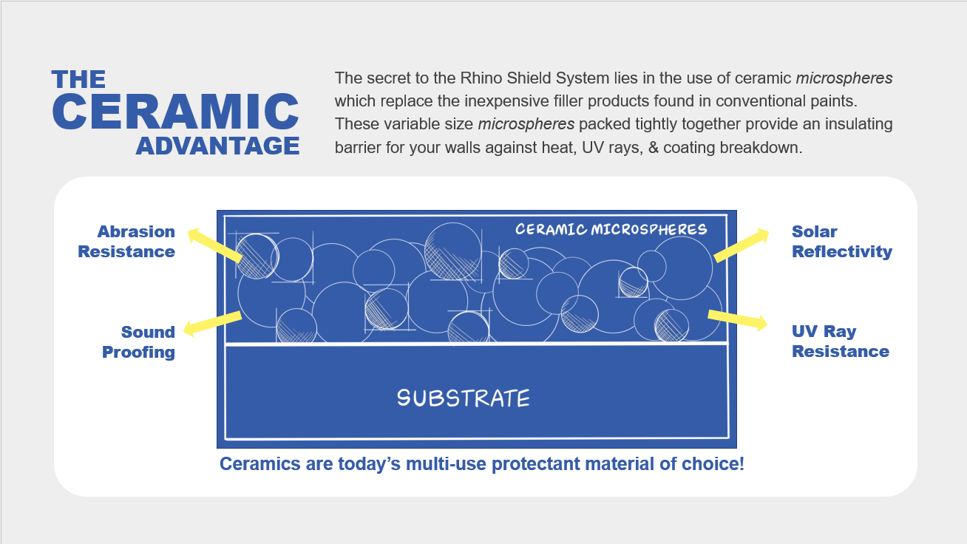

Slide 14


Slide 15


Slide 16
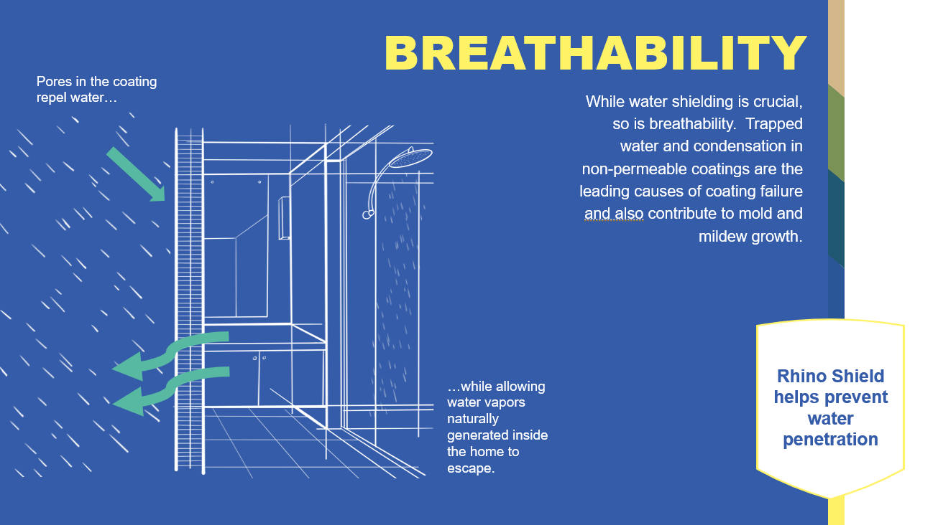

Slide 17

Unique Selling proposition
In a sea of painters, stand out with Rhino Shield
Anyone can paint a house. Only Rhino Shield Authorized Dealers can Shield your home.
You can bring a National, Branded Coatings Solution to your customers. As the Local Dealer, you stand with your customer, and we stand behind the product.

Slide 18
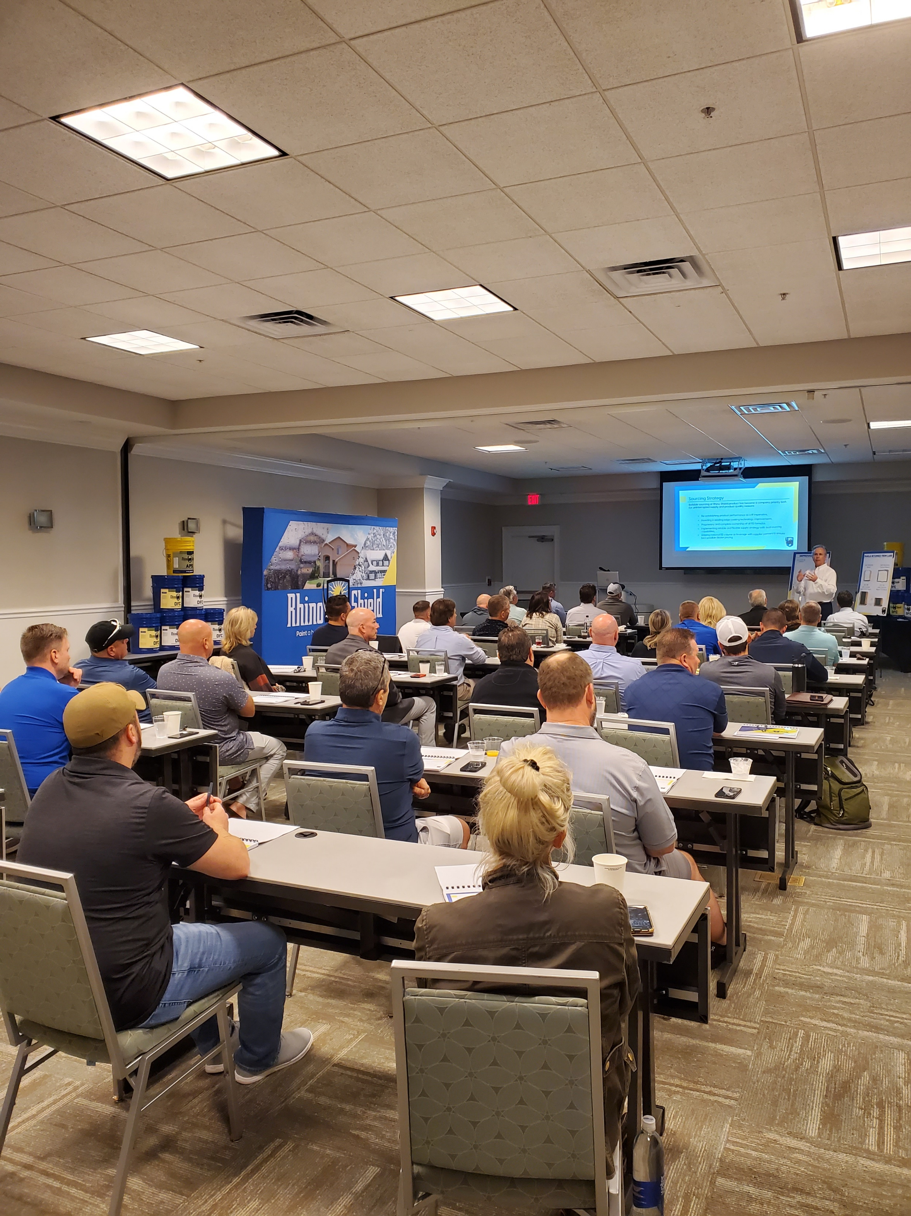
Training
AmCoat provides its’ Dealers with robust Training Support including:
Marketing Training & Support
Sales Training & Support
Installation and Technical Training
On-Going Support
National Dealership Meeting
*CEO Terry Andre addresses Dealer Owners at the 2022 National Dealer Meeting

Slide 19
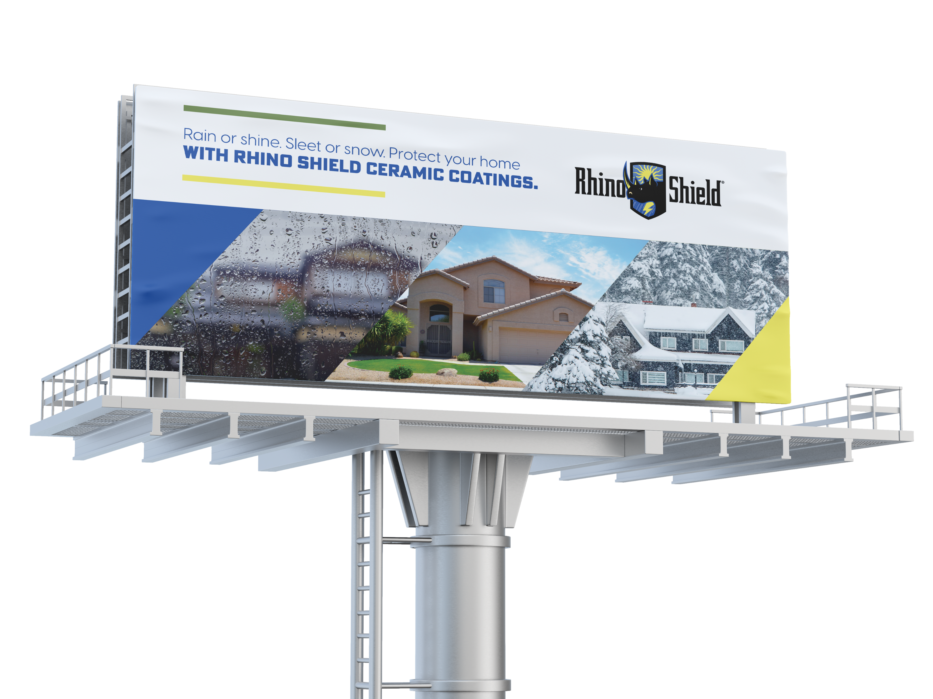


Marketing Support
AmCoat provides its’ Dealers with robust Marketing Support including:
Customer Testimonial Videos
Brochures
Product Samples
Sample TV and Radio Spots
Print Ad Examples

Slide 20

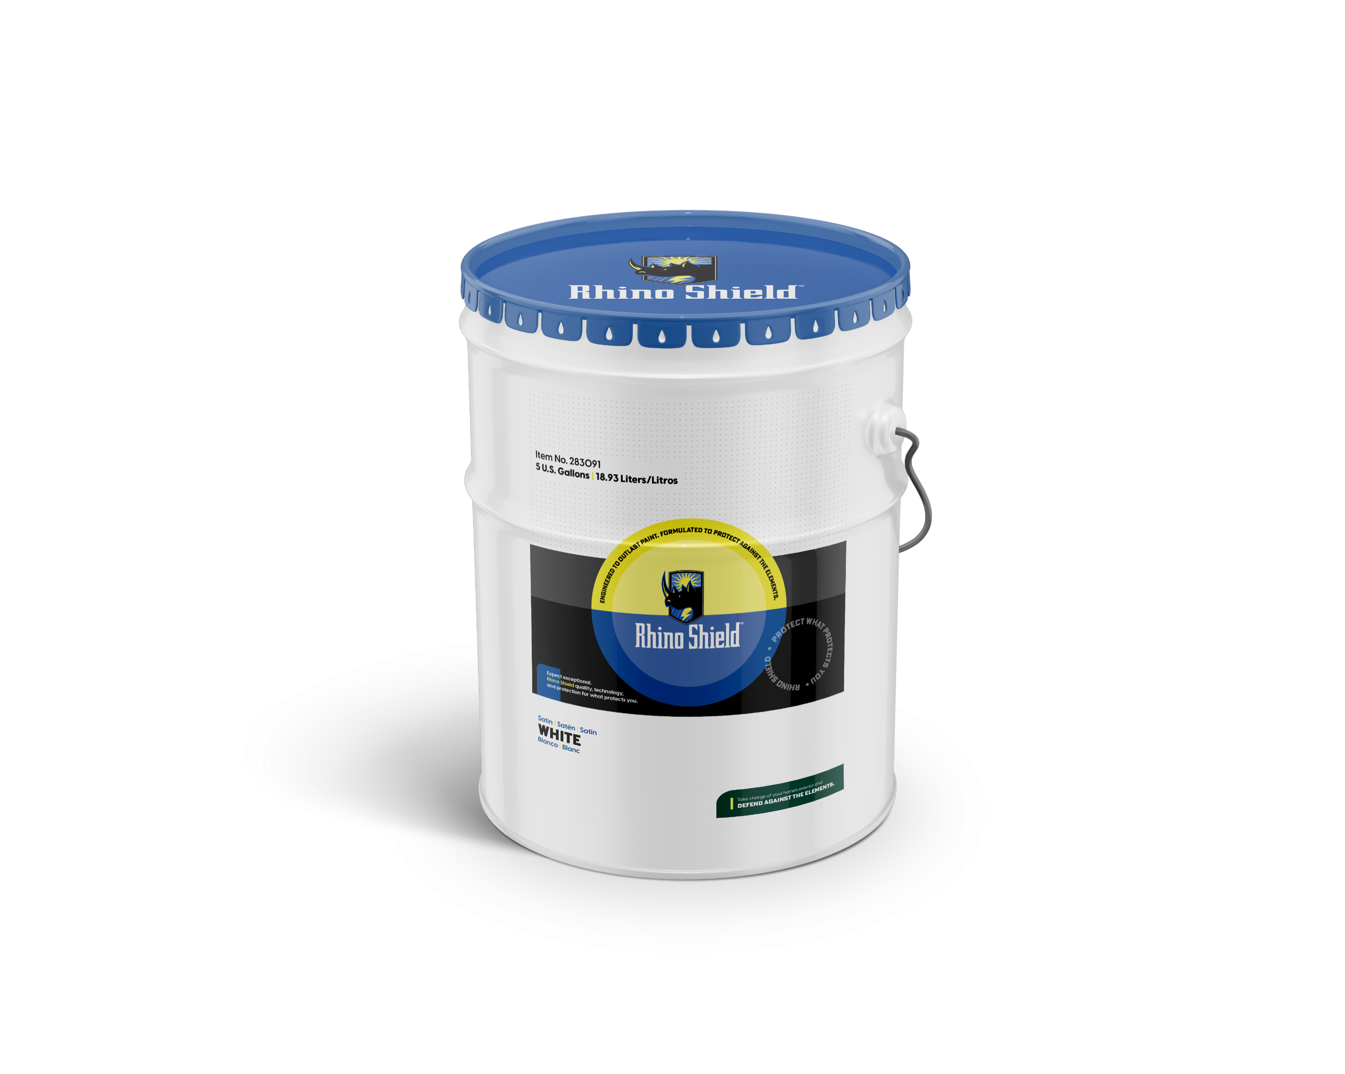
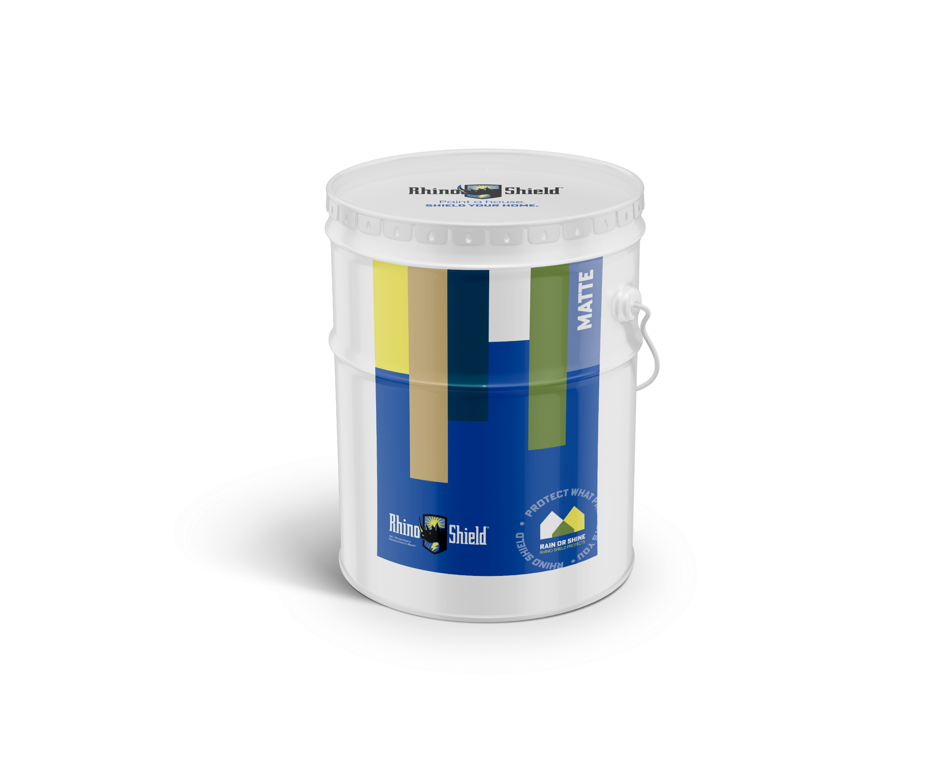

Marketing Support
Home Show Aides
Photo Galleries
Product Placement Videos (HGTV, PBS, etc…)
Rhino Shield Store
Product Testing Reports and Certifications
Commercial Market Marketing and Sales Tools
On-Going Support
Notes:
Key Headlines in use—again ready to go today or use the assets to develop your own. There are two taglines, but many headlines.
Decades of Defense against Mother Nature’s Wear and Tear
that same billboard image is in infographic form here rain/snow/sun
Call out each one.

Slide 21

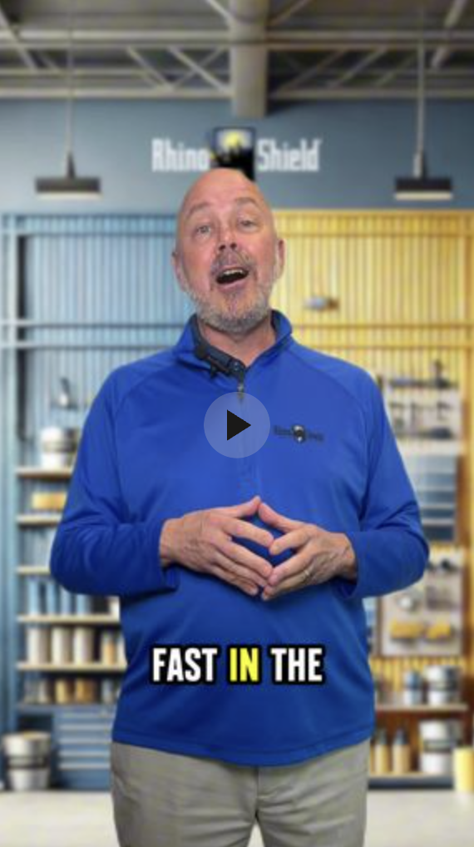
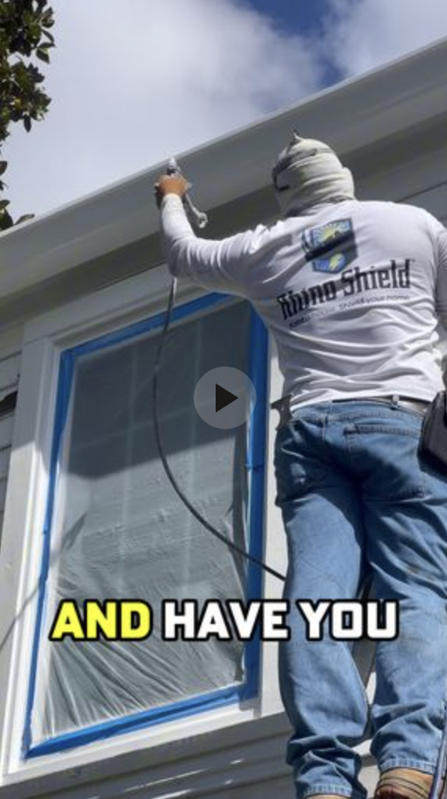

MARKETING Support
Ad creatives
  High-performing vertical shorts
  Graphics
Marketing partner and agency support
Regular follow-ups to ensure performance
And so much more!

Slide 22
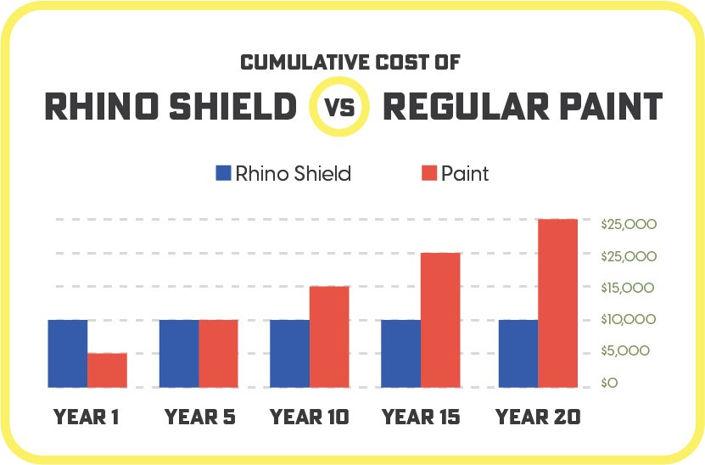
Sales Support
Complete Sales Training Program
  Rhino Shield 10-Step Sales System
Pitch Books (print and laptop versions)
Sales Kits (Full and Clipboard)
Contracts, Forms, Paperwork
Dealer Portal
On-Going Sales Support

Slide 23
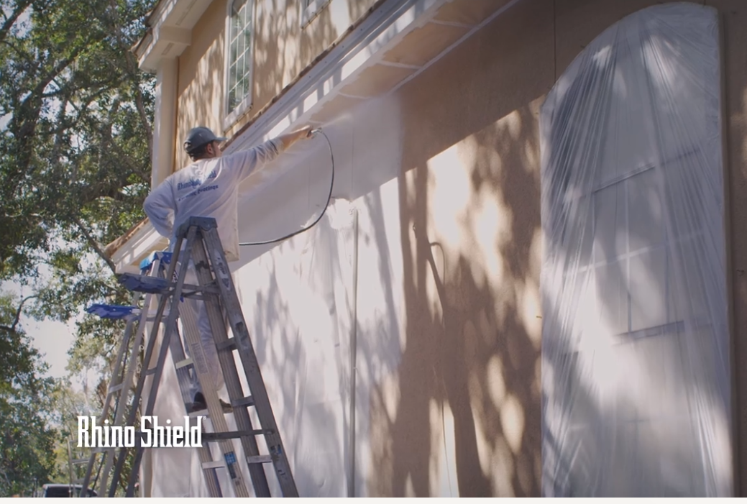
Installation Support
Installation Training
Application Manuals
Training Video
Product and Safety Data Sheets
Pre-job Installation Assessment
Service Issue Analysis
Product Recommendations
On-Going In-Field Support

Slide 24

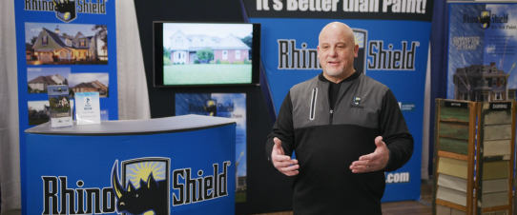

Dealer Economics
Typical Rhino Shield dealers gross $1.5M+ in gross revenue
Gross profits of 55-60%
Net profit margins of 15-20%

Slide 25
Dealer Economics
Average retail/sq. ft.: $4.50-$6.00+
Average Gross Margin: 55-60%
Typical Dealer P&L Breakdown
  Material: 13-15% of revenue
  Labor: 25-30%
  Gross Margin: 55%-60%
  Variable Expenses
  Marketing: 15-18%
  Sales Commissions: 10-12%
  Admin./Other: 10-15%
  Net Profit: 15-20%

Slide 26
Start today
Build a million-dollar business with less than
$75,000 as an initial investment.
Exclusive Territory
No-Franchise Fees
Robust Marketing Support
Complete Sales Training
Installation & Crew Training
Dealer & Financial Management Guidance

Slide 27
Dealership Opportunity

